Slide 1


Slide 2


Slide 3
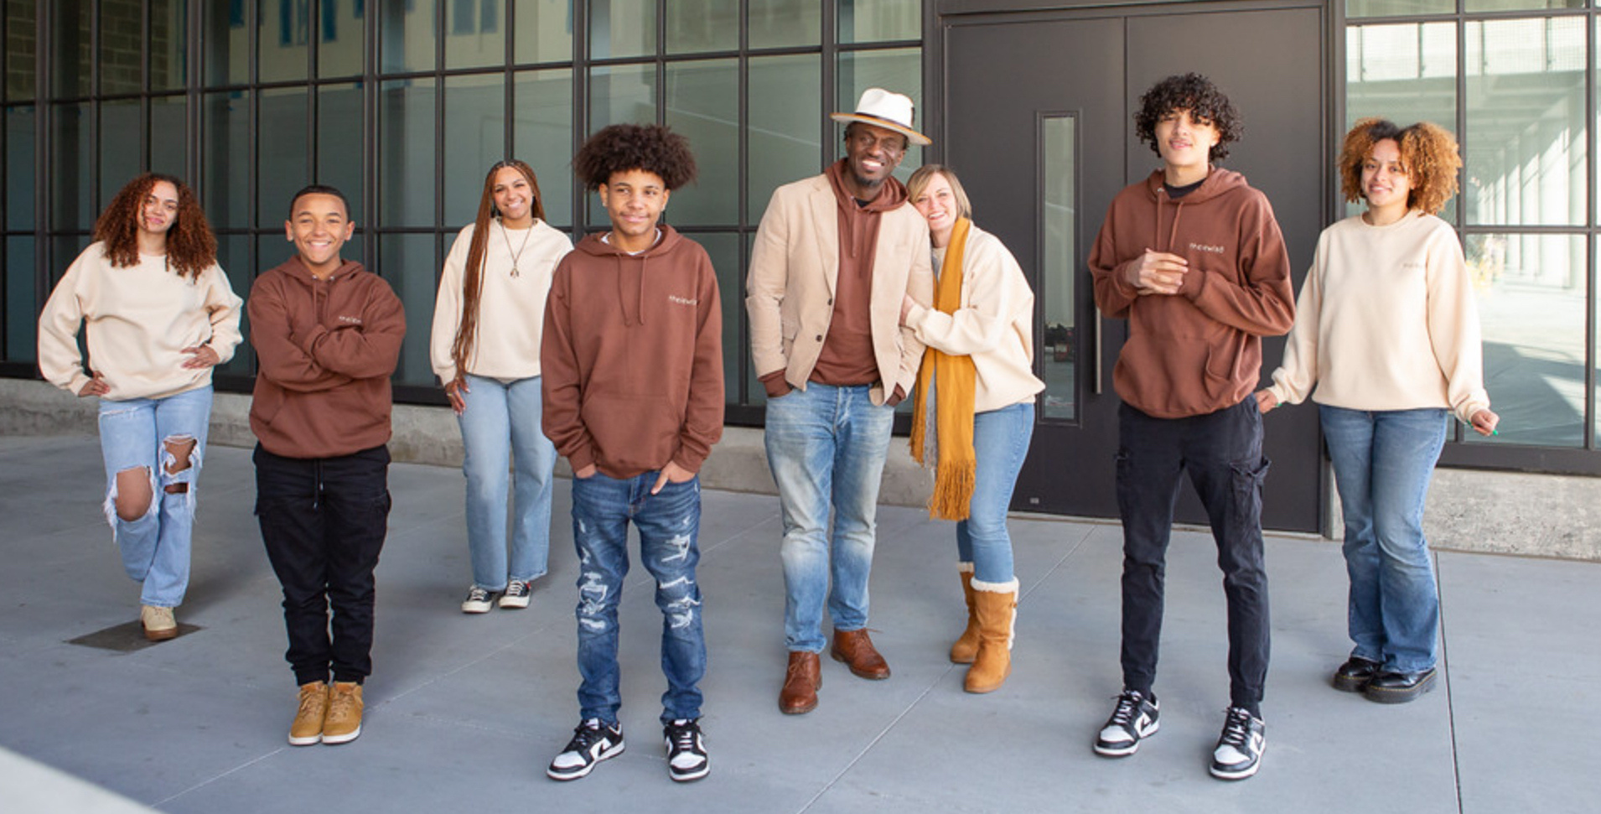

Slide 4


Plentiful Harvest
shortage of laborers

Slide 5



Slide 6

17 From then on Jesus began to preach, “Repent, because the kingdom of heaven has come near.” 18 As he was walking along the Sea of Galilee, he saw two brothers, Simon (who is called Peter), and his brother Andrew. They were casting a net into the sea ​— ​for they were fishermen. 19 “Follow me,” he told them,“and I will make you fish for people.”
Matthew 4:17-19 (CSB)

Slide 7


THE Mechanics of discipleship IS an invitation into relationship and a challenge to change.

Slide 8
35 Jesus continued going around to all the towns and villages, teaching in their synagogues, preaching the good news of the kingdom, and healing every disease and every sickness. 36 When he saw the crowds, he felt compassion for them, because they were distressed and dejected, like sheep without a shepherd.
Matthew 9:35-36 (CSB)

Slide 9
37 Then he said to his disciples, “The harvest is abundant, but the workers are few. 38 Therefore, pray to the Lord of the harvest to send out workers into his harvest.”
Matthew 9:37-38 (CSB)

Slide 10

"sENT"
"forced out"
Ekballow

Slide 11
Summoning his twelve disciples, he gave them authority over unclean spirits, to drive them out and to heal every disease and sickness.
Matthew 10:1 (CSB)

Slide 12
Jesus sent out these twelve after giving them instructions: “Don’t take the road that leads to the Gentiles, and don’t enter any Samaritan town.
Matthew 10:5 (CSB)

Slide 13
"sENT"
"forced out"
"sENT"
"SPECIFIC PURPOSE"
Ekballow
Apostello

Slide 14
16 “Look, I’m sending you out like sheep among wolves. Therefore be as shrewd as serpents and as innocent as doves.
Matthew 10:16 (CSB)

Slide 15
7 Jesus responded,“Blessed are you, Simon son of Jonah, because flesh and blood did not reveal this to you, but my Father in heaven. 18 And I also say to you that you are Peter, and on this rock I will build my church, and the gates of Hades will not overpower it.
Matthew 16:18 (CSB)

Slide 16

"sENT"
"forced out"
"sENT"
"SPECIFIC PURPOSE"
Ekballow
Apostello
Passion

Slide 17
7 Jesus responded,“Blessed are you, Simon son of Jonah, because flesh and blood did not reveal this to you, but my Father in heaven. 18 And I also say to you that you are Peter, and on this rock I will build my church, and the gates of Hades will not overpower it.
Matthew 22:37-38 (CSB)

Slide 18
18 Jesus came near and said to them,“All authority has been given to me in heaven and on earth. 19 Go, therefore, and make disciples of all nations, baptizing them in the name of the Father and of the Son and of the Holy Spirit, 20 teaching them to observe everything I have commanded you. And remember, I am with you always, to the end of the age.”
Matthew 28:19-20 (CSB)

Slide 19
verbs of being and making disciples

Slide 20
verbs of being and making disciples
  Surrendering

Slide 21
verbs of being and making disciples
  Surrendering
  Going

Slide 22
verbs of being and making disciples
  Surrendering
  Going
  Baptizing

Slide 23
verbs of being and making disciples
  Surrendering
  Going
  Baptizing
  Teaching

Slide 24
verbs of being and making disciples
  Surrendering
  Going
  Baptizing
  Teaching
  Remembering

